Slide 1
Project 4 Natural language processing using Wikipedia api
Joyce Lin, General assembly, data science immersive

Slide 2
Project pipeline
Pre Process
TFIDF
Pre Process
SVD(LSA)
Data Collection
From
Wikipedia
Supervised
Decision Tree
Pre Process
Data Cleaning
Mongo
Redis
Supervised
K Neighbor Classifier
Unsupervised
Cosine Similarity
Pre Process
Vectorizing
spacy
Unsupervised
Nearest Neighbor

Slide 3
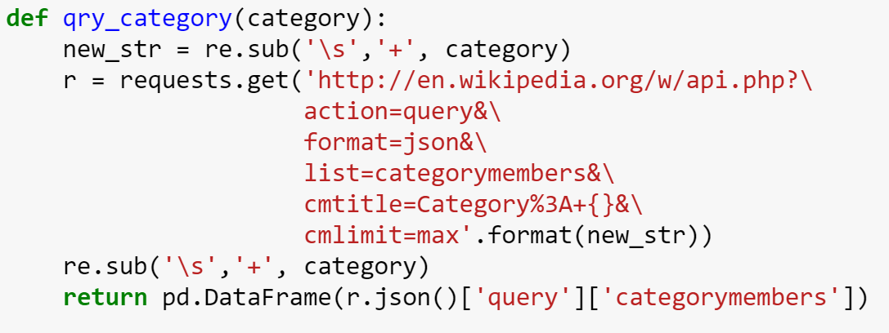
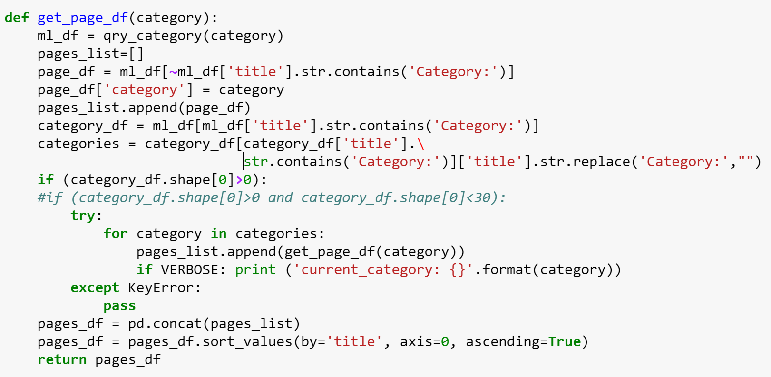
Data Collection
Used Wikimedia API search query to request page id and title
Collect page title from sub-categories using recursive method

Slide 4
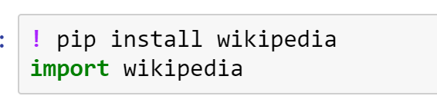
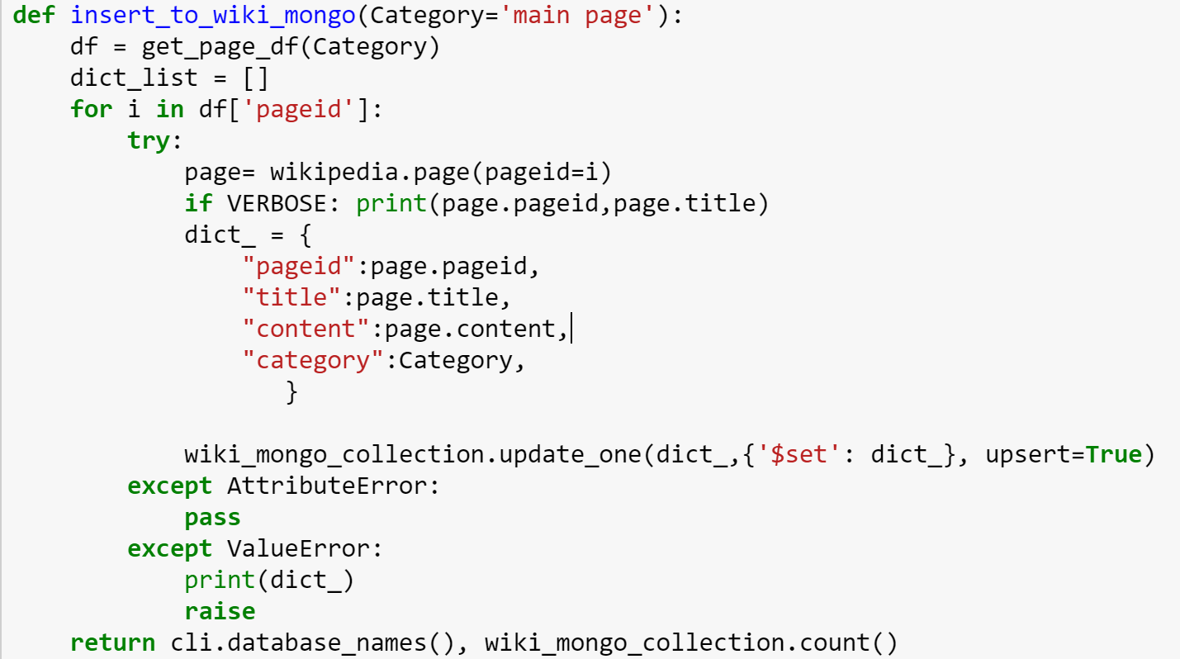
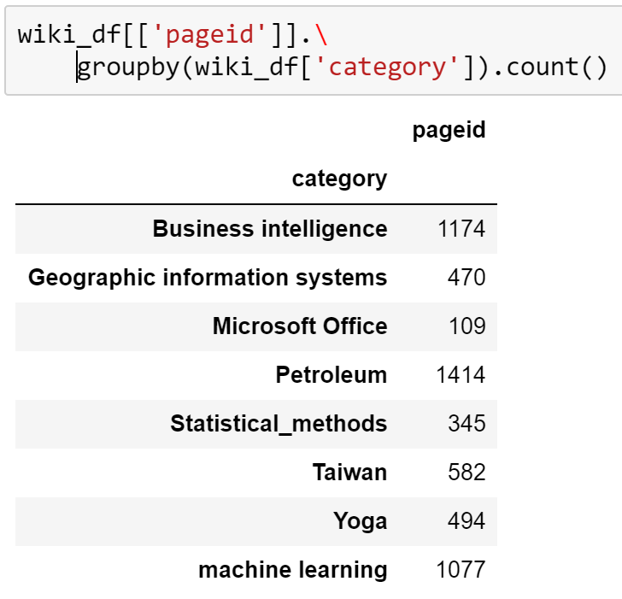
Data Collection
Use wikipedia library to pull page content based on page title
Insert each document into my wiki Mongo Collection

Slide 5
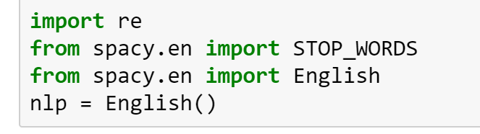
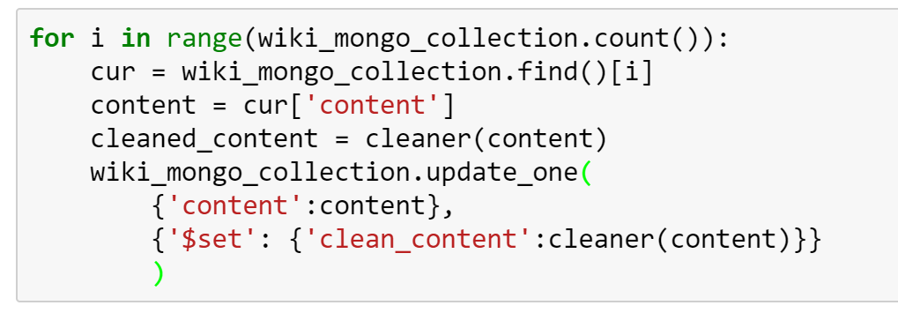
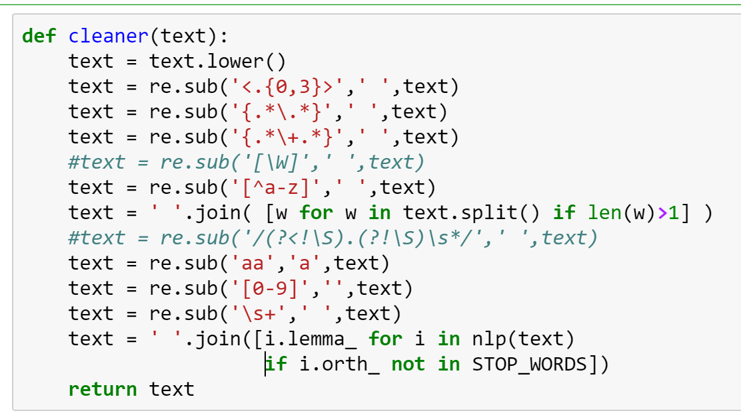
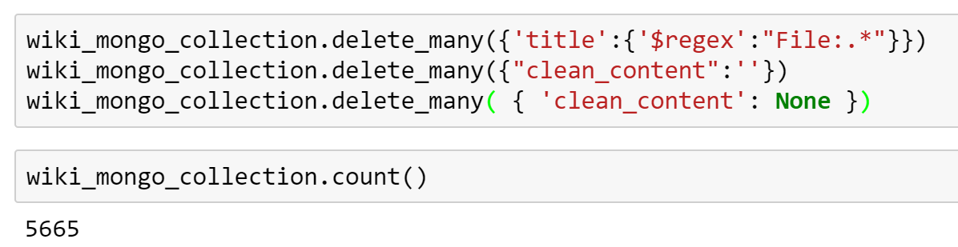
Preprocessing - Data cleaning
Clean article content with regex
Tokenize content into text using lemmatization method for removing stop words
Save cleaned content back to my wiki mongo collection

Slide 6
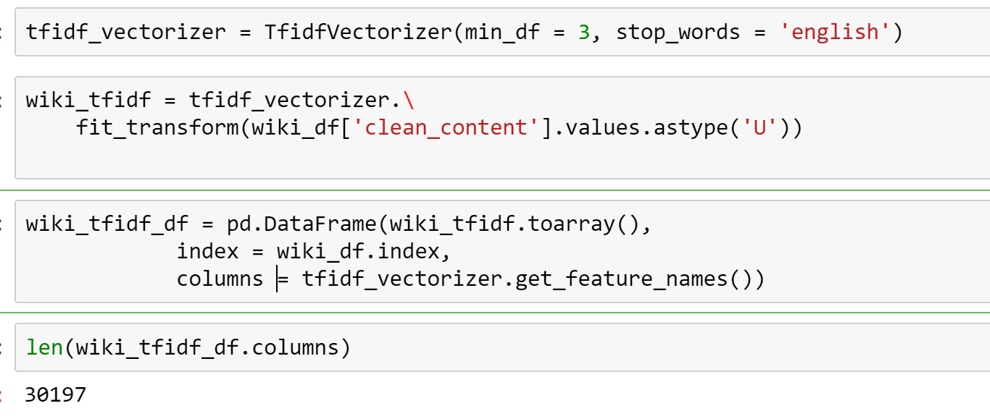
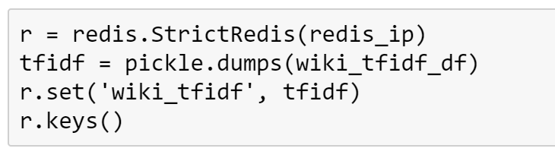
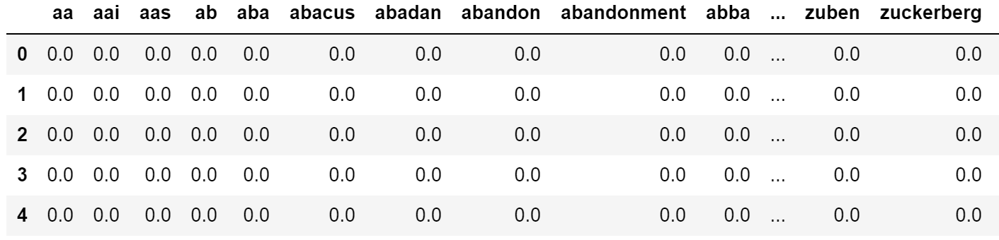
Preprocessing - TIFIDF
Get bag of words using TIFIDF
Dump table into redis
Text Frequency * Inverse Document Frequency

Slide 7
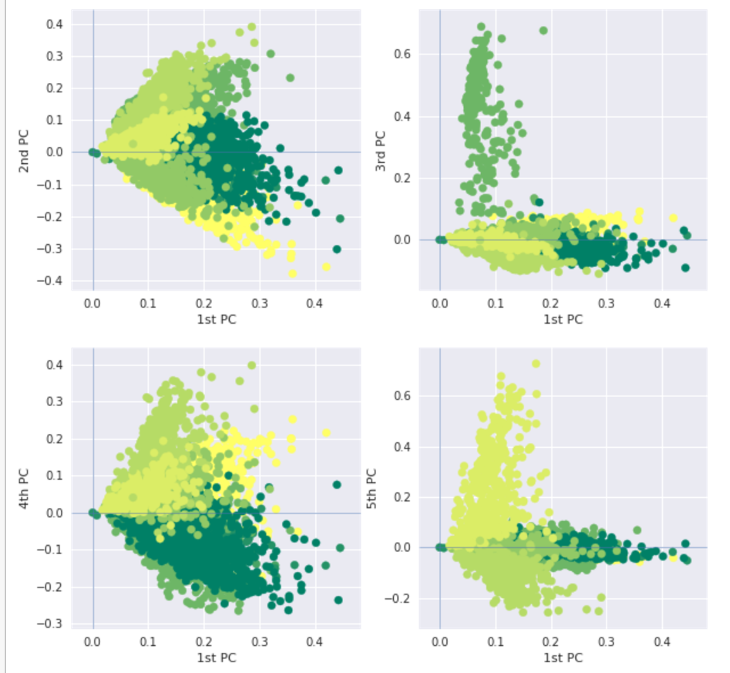
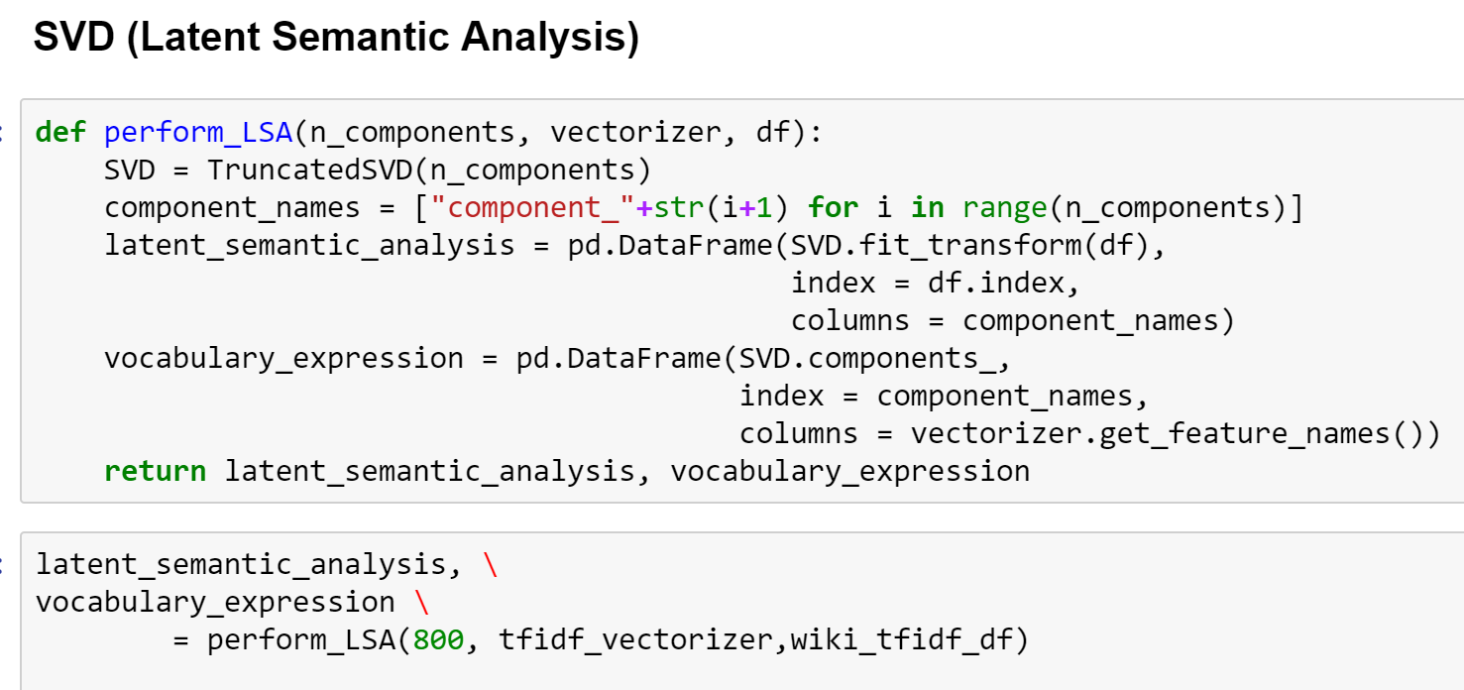
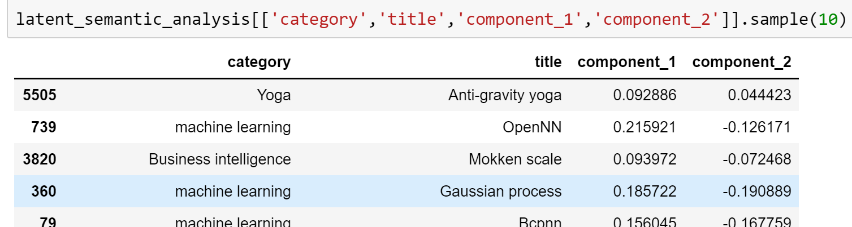
Preprocessing - LSA
Fit and transform TIFIDF dataframe to truncated SVD model
N_components = 800

Slide 8
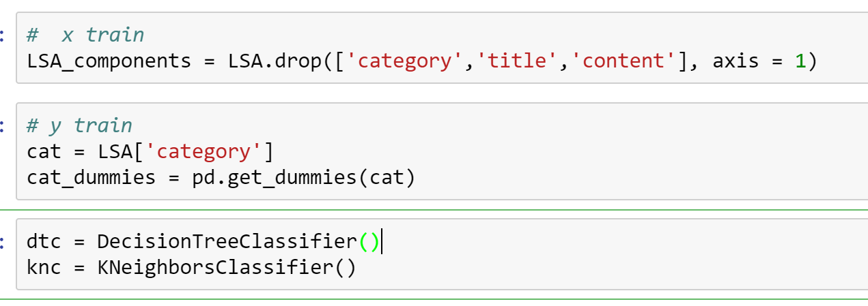
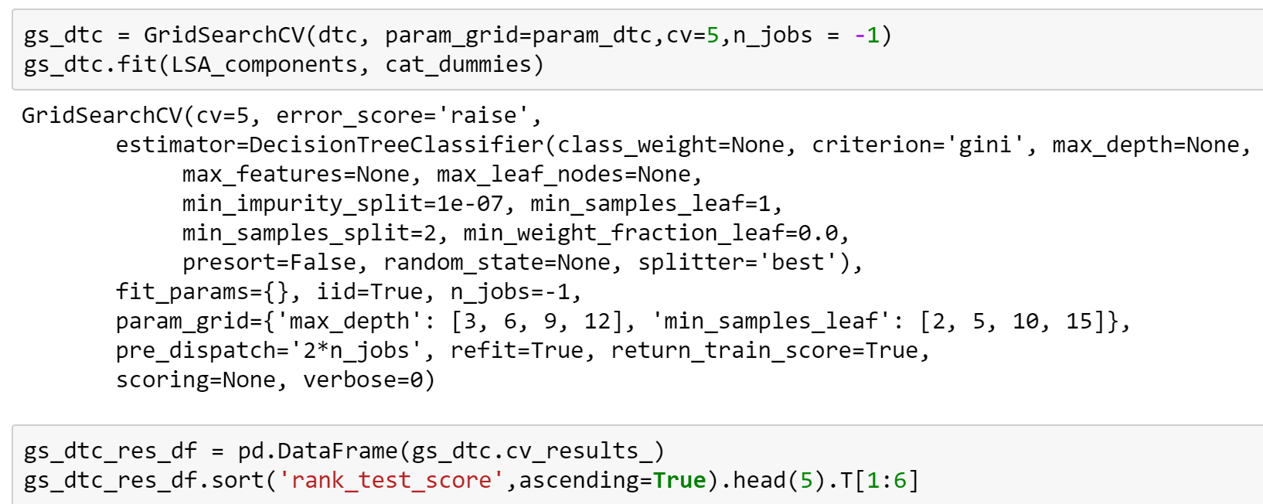
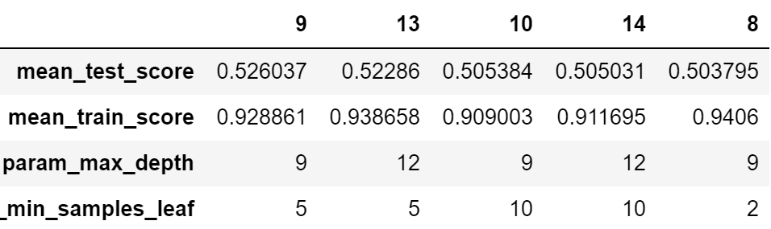
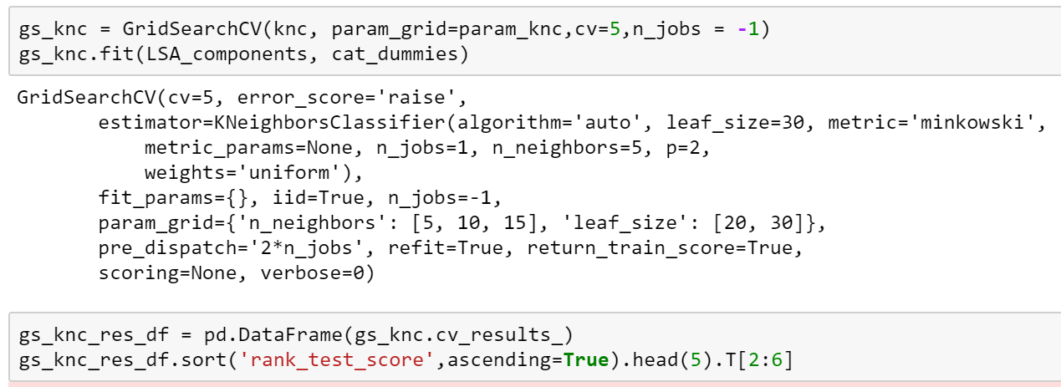
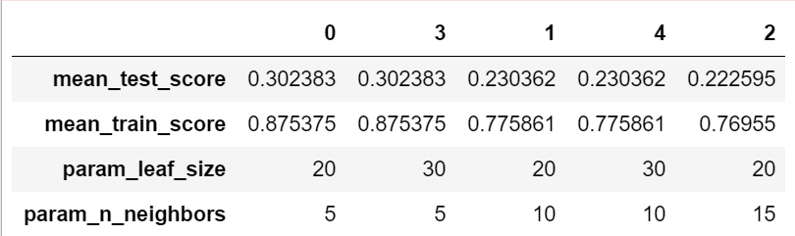
Prediction - supervised

Slide 9
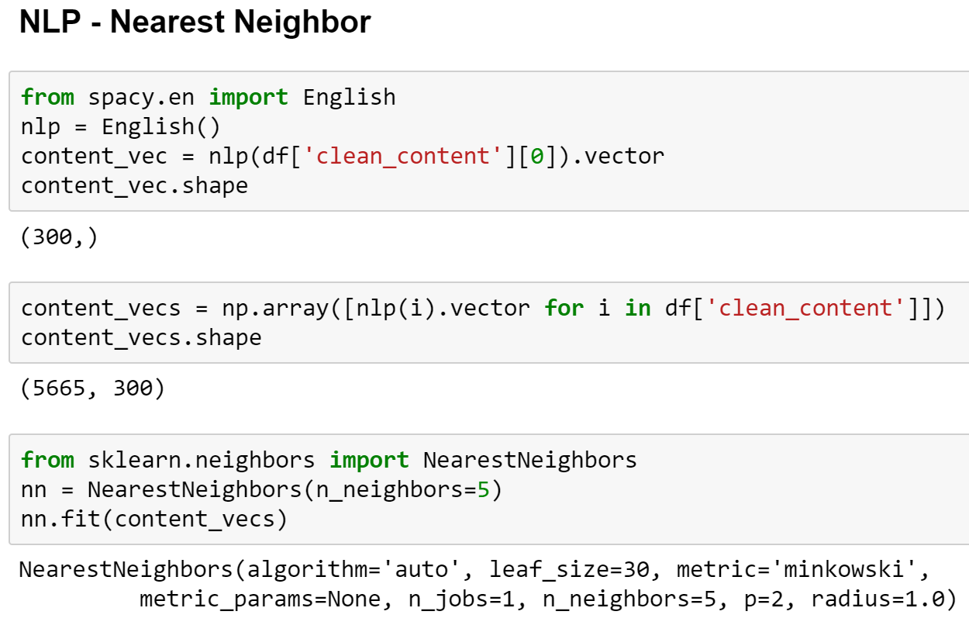
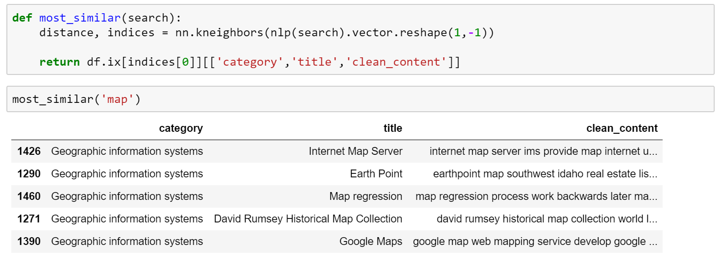
Prediction – unsupervised (Nearest Neighbor)

Slide 10
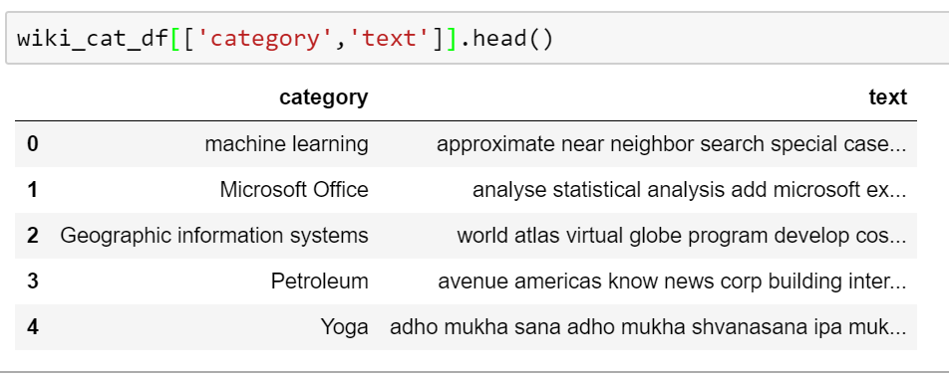
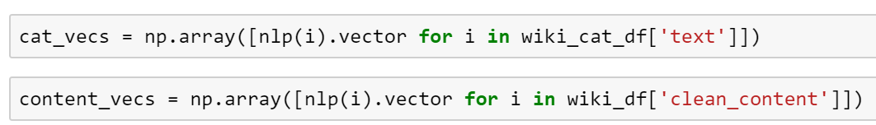
Prediction – unsupervised Cosine similarity
Combine Wikipedia page content from a single category into one string
Vectorize the “category string” as well as the “ page string”

Slide 11
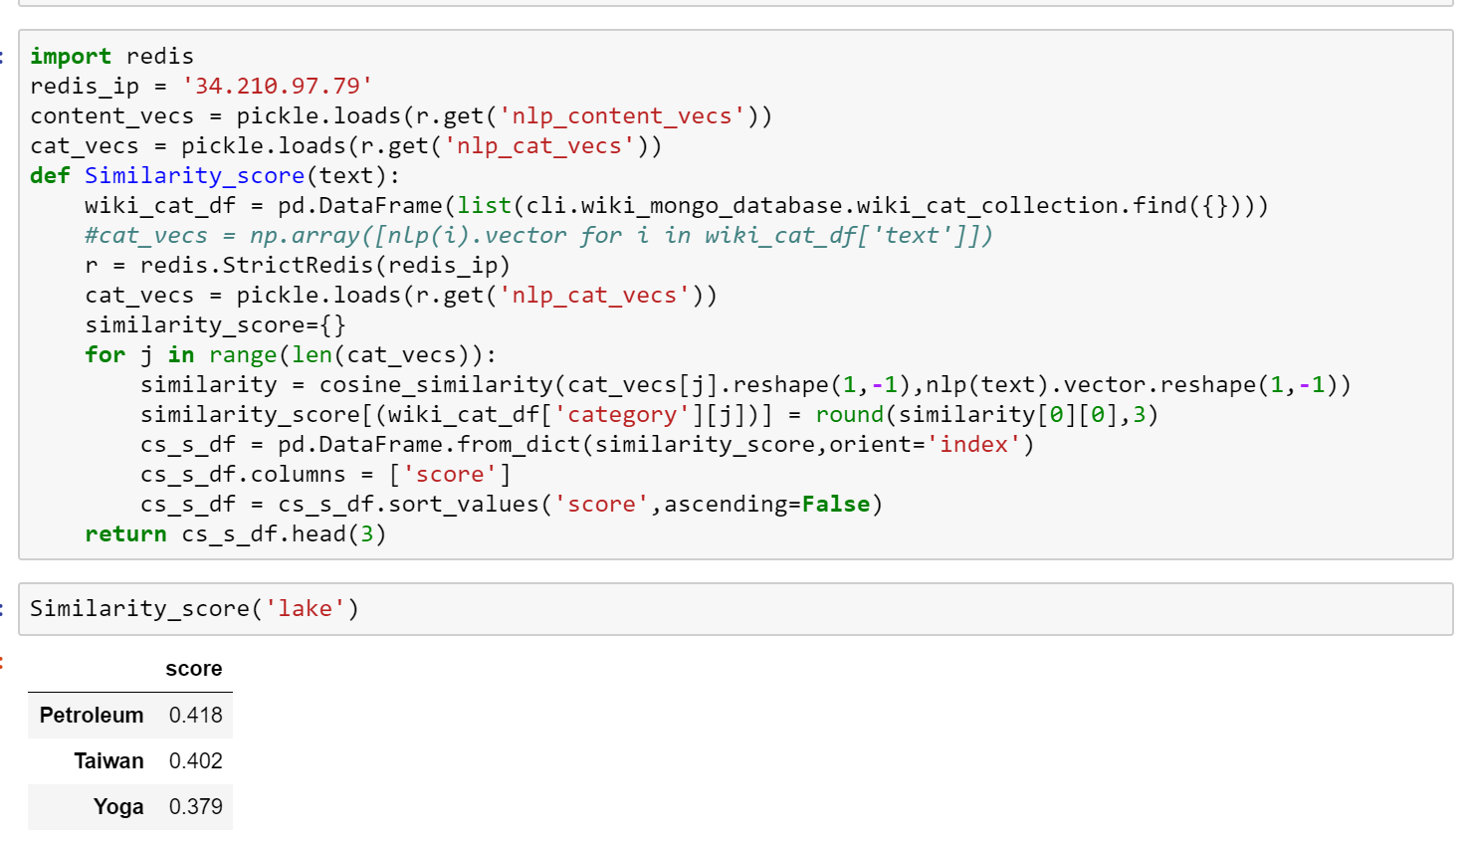
Prediction – unsupervised Cosine similarity
Get COSINE SIMILARITY SCORE by “strings”

Slide 12
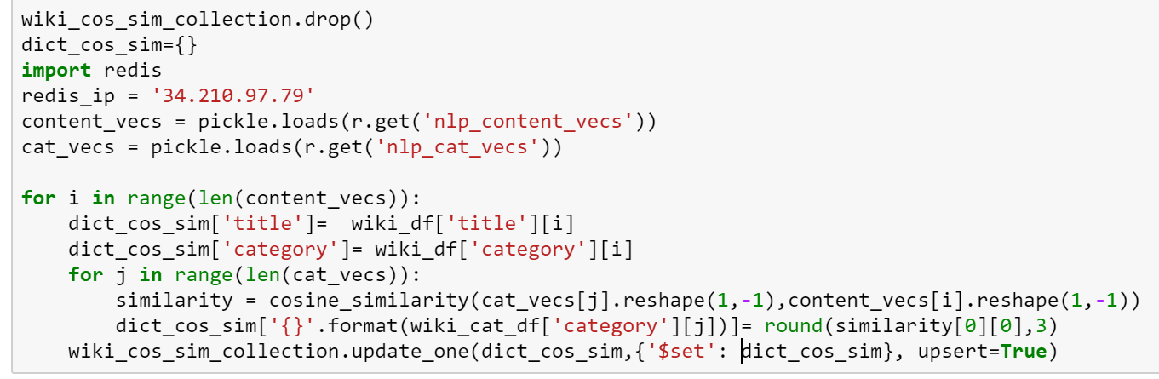
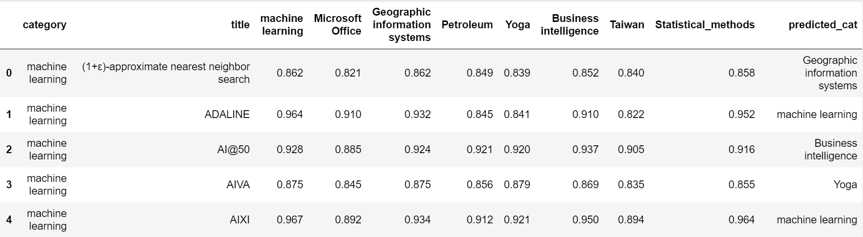
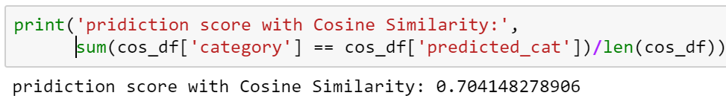
Prediction – unsupervised Cosine similarity
Run Cosine Similarity score on Wikipedia page content again each category
Assign the category that gets the highest cosine similarity score as predicted category by each page
Cosine Similarity Accuracy = (right prediction)/ (total predicted)

Slide 13
Project learned
Be mindful on using recursive method
Better to pull one article and insert into database at a time
Memory issue
There is no true test/ train split on this prediction model

Slide 14
Further study
Build python script for data collection
Error handing on memory issue
Further tuning on LSA n_component
Notes:
r = redis.StrictRedis(redis_ip)
r.pipeline()

